Slide 1

Noida Institute of Engineering and Technology, Greater Noida
OBJECT ORIENTED TECHNIQUES USING JAVA(ACSE0302)
Unit: 1
Heena bhalla
Assistant Professor
IT Department
Introduction
Course Details (B Tech 3rdSem /2nd Year)

Slide 2
Introduction of Faculty member
B.Tech (CSE) from Radha Govind Group of Institutions Meerut (2012-2016) M.Tech (CSE) from Ajay Kumar Garg Engineering College, Ghaziabad (2018-2020), Specialization in Machine Learning (NLP) Coding Languages : Java, Python, C, Swift* Research Publications: Journal – 4 Conference – 1 Book Chapter - 1

Slide 3
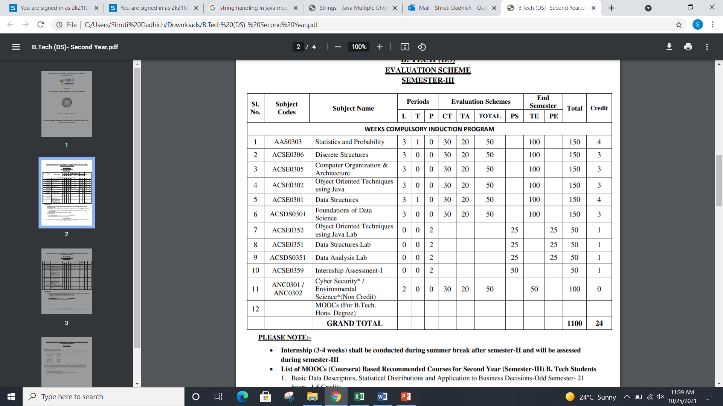
Evaluation Scheme

Slide 4
Subject Syllabus
UNIT-I | Introduction | 8 Hours
Object Oriented Programming: Introduction and Features: Abstraction, Encapsulation, Polymorphism, and Inheritance. Modeling Concepts: Introduction, Class Diagram and Object Diagram. Control Statements: Decision Making, Looping and Branching, Argument Passing Mechanism: Command Line Argument
UNIT-II | Basics of Java Programming | 8 Hours
Class and Object: Object Reference, Constructor, Abstract Class, Interface and its uses, Defining Methods, Use of “this” and “super” keyword, Garbage Collection and finalize () Method. Inheritance: Introduction and Types of Inheritance in Java, Constructors in Inheritance. Polymorphism: Introduction and Types, Overloading and Overriding. Lambda expression: Introduction and Working with Lambda Variables. Arrays: Introduction and its Types.

Slide 5
Subject Syllabus
UNIT-III | Packages, Exception Handling and String Handling | 8 hours
Packages: Introduction and Types, Access Protection in Packages, Import and Execution of Packages. Exception Handling, Assertions and Localizations: Introduction and Types, Exceptions vs. Errors, Handling of Exception. Finally, Throws and Throw keyword, Multiple Catch Block, Nested Try and Finally Block. Assertions and Localizations Concepts and its working. String Handling: Introduction and Types, Operations, Immutable String, Method of String class, String Buffer and String Builder class
UNIT-IV | Concurrency in Java and I/O Stream | 8 hours
Threads: Introduction and Types, Creating Threads, Thread Life-Cycle, Thread Priorities, Daemon Thread, Runnable Class, Synchronizing Threads. I/O Stream: Introduction and Types, Common I/O Stream Operations, Interaction with I/O Streams Classes. Annotations: Introduction, Custom Annotations and Applying Annotations.
UNIT-V | GUI Programming, Generics and Collections | 8 hours
GUI Programming: Introduction and Types, Applet, Life Cycle of Applet, AWT, Components and Containers, Layout Managers and User-Defined Layout and Event Handling. Generics and Collections: Introduction, Using Method References, Using Wrapper Class, Using Lists, Sets, Maps and Queues, Working with Generics.

Slide 6
IT Applications
Java can be used :
Data import and export.
Cleaning data.
Statistical analysis.
Machine learning and Deep learning.
Deep learning.
Text analytics (also known as Natural Language Processing or NLP).
Data visualization.

Slide 7
COURSE OBJECTIVES
The objective of this course is to understand the object-oriented methodology and its techniques to design and develop conceptual models and demonstrate the standard concepts of object-oriented techniques modularity, I/O. and other standard language constructs. The basic objective of this course is to understand the fundamental concepts of object-oriented programming in Java language and also implement the Multithreading concepts, GUI based application and collection framework.

Slide 8
COURSE OUTCOME
After completion of this course students will be able to:
CO1 | Identify the concepts of object oriented programming and relationships among them needed in modeling.
CO2 | Demonstrate the Java programs using OOP principles and also implement the concepts of lambda expressions.
CO3 | Implement packages with different protection level resolving namespace collision and evaluate the error handling concepts for uninterrupted execution of Java program.
CO4 | Implement Concurrency control, I/O Streams and Annotations concepts by using Java program.
CO5 | Design and develop the GUI based application, Generics and Collections in Java programming language to solve the real-world problem.

Slide 9
Program Outcomes (POs)
After completion of this course students will be able to:
PO1 | To understand how to design and implement basic data types, command line arguments and control statements
PO2 | To demonstrate the Java programs using OOP principles and also implement the concepts of lambda expressions and arrays.
PO3 | To demonstrate, understand and use of different exceptional handling mechanisms, assertions, localizations and string handling.
PO4 | To solve the real time problems using multithreading and annotations concept.
PO5 | To design and develop collections and generic classes in JAVA programming language

Slide 10
CO-PO and PSO Mapping
Mapping of Course Outcomes and Program Outcomes:
 |  |  |  | Object OrientedTechniques using Java
CO | PO1 | PO2 | PO3 |  | PO4 | PO5 | PO6 | PO7 | PO8 | PO9 | PO10 | PO11 | PO12
CO1 | 3 | 3 | 3 |  | 3 | 2 | 2 | 1 | - | 1 | - | 2 | 2
CO2 | 3 | 3 | 3 |  | 3 | 2 | 2 | 1 | - | 1 | 1 | 2 | 2
CO3 | 3 | 3 | 3 |  | 3 | 3 | 2 | 2 | - | 2 | 1 | 2 | 3
CO4 | 3 | 3 | 3 |  | 3 | 3 | 2 | 2 | 1 | 2 | 1 | 2 | 3
CO5 | 3 | 3 | 3 |  | 3 | 3 | 2 | 2 | 1 | 2 | 1 | 2 | 2
Average | 3 | 3 | 3 |  | 3 | 2.6 | 2 | 1.6 | 0.4 | 1.6 | 0.8 | 2 | 2.2

Slide 11
Program Specific Outcomes (PSO)
On successful completion of B. Tech. (I.T.) Program, the Information Technology graduates will be able to:
PSO1 | Work as a software developer, database administrator, tester or networking engineer for providing solutions to the real world and industrial problems.
PSO2 | Apply core subjects of information technology related to data structure and algorithm, software engineering, web technology, operating system, database and networking to solve complex IT problems.
PSO3 | Practice multi-disciplinary and modern computing techniques by lifelong learning to establish innovative career.
PSO4 | Work in a team or individual to manage projects with ethical concern to be a successful employee or employer in IT industry.

Slide 12
CO-PO and PSO Mapping
Mapping of Course Outcomes and Program Specific Outcomes:
Object OrientedTechniques using Java
CO.K | PSO1 | PSO2 | PSO3 | PSO4
CO1 | 2 | 3 | 2 | 2
CO2 | 2 | 3 | 2 | 2
CO3 | 2 | 3 | 3 | 3
CO4 | 3 | 3 | 3 | 3
CO5 | 3 | 3 | 3 | 3
Average | 2.4 | 5 | 2.6 | 2.6

Slide 13
Program Education Objectives
Program Education Objectives
PEO’S of the B. Tech. in Information Technology are:
The graduates will be able to:
PEO1: Apply sound knowledge in the field of information technology to fulfill the needs of IT industry.
PEO2: Design innovative and interdisciplinary systems through latest digital technologies.
PEO3: Inculcate professional – social ethics, team work and leadership for serving the society.
PEO4: Inculcate lifelong learning in the field of computing for successful career in organizations and R&D sectors.

Slide 14
Prerequisite
Student must know at least the basics of how to use a computer, and should be able to start a command line shell.
Knowledge of basic programming concepts, as covered in ‘Programming Basic” course is necessary.

Slide 15
About the Subject with videos
OOTS refers to languages that uses objects in programming.
OOTS aims to implement real-world entities like inheritance, hiding, polymorphism etc in programming.
The main aim of OOTS is to bind together the data and the functions that operate on them so that no other part of the code can access this data except that function
Link:
Unit 1 | https://www.youtube.com/watch?v=r59xYe3Vyks&list=PLS1QulWo1RIbfTjQvTdj8Y6yyq4R7g-Al
Unit 2 | https://www.youtube.com/watch?v=ZHLdVRXIuC8&list=PLS1QulWo1RIbfTjQvTdj8Y6yyq4R7g-Al&index=18
Unit 3 | https://www.youtube.com/watch?v=hBh_CC5y8-s
Unit 4 | https://www.youtube.com/watch?v=qQVqfvs3p48
Unit 5 | https://www.youtube.com/watch?v=2qWPpgALJyw

Slide 16
UNIT CONTENTS
Object Oriented Programming
Introduction and Features
Abstraction
Encapsulation
Polymorphism
Inheritance.
Modeling Concepts
Class Diagram

Slide 17
UNIT CONTENTS(Cont.)
Object Diagram.
Control Statements
Decision Making
Looping
Branching
Argument Passing Mechanism
Command Line Argument.

Slide 18
UNIT OBJECTIVE
Objective of this unit to understand the concept of OOPs.
Objective of this unit to understand the modeling concept and control statement.

Slide 19
Topic Objective
After you have read and studied this topic, you should be able to
To learn the Object Oriented Concepts in Java.
To learn the concept of how to initialize object in memory.
To Understand the application of instance, static method.
To learn the concepts of code reusability and Polymorphism .
To explore the knowledge of Lambda function and Array Object.

Slide 20
Object Oriented Programming
Why Do We Need Object‐Oriented Programming?
Object‐Oriented Programming was developed because limitations were discovered in earlier approaches to programming.
To appreciate what OOP does, we need to understand what these limitations are and how they arose from traditional programming languages.

Slide 21
Object Oriented Programming
Procedure‐Oriented Programming
C, Pascal, FORTRAN, and similar languages are procedural languages.
Each statement in the language tells the computer to do something:
– get some input
– add these numbers
– divide by 6
– display that output
A program in a procedural language is a list of instructions.

Slide 22
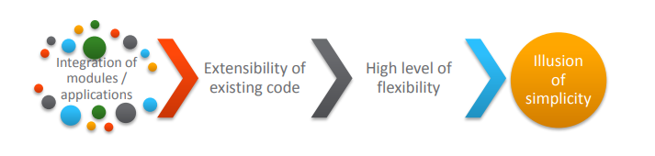
Need for Object Oriented Approach
Challenges in developing a business application.
If these challenges are not addressed, it may lead to software crisis.

Slide 23
Object Oriented Programming
Procedure‐Oriented Programming
Procedural program is divided into functions
•Each function has a clearly defined purpose and a clearly defined interface to the other functions in the program.
•The idea of breaking a program into functions can be further extended by grouping a number of functions together into a larger entity called a module.

Slide 24
Object Oriented Programming
Procedure‐Oriented Programming Drawbacks:
Since every function has complete access to the global variables, the new programmer can corrupt the data accidentally by creating function.
We can access the data of one function from other since, there is no protection.
In large program it is very difficult to identify what data is used by which function.
Similarly, if new data is to be added, all the function needed to be modified to access the data.

Slide 25
Object Oriented Programming
Procedural Oriented Programming | Object Oriented Programming
In procedural programming, program is divided into small parts called functions. | In object oriented programming, program is divided into small parts called objects.
Procedural programming follows top down approach. | Object oriented programming follows bottom up approach.
There is no access specifier in procedural programming. | Object oriented programming have access specifiers like private, public, protected etc.
Adding new data and function is not easy. | Adding new data and function is easy.
Procedural programming does not have any proper way for hiding data so it is less secure. | Object oriented programming provides data hiding so it is more secure.
In procedural programming, overloading is not possible. | Overloading is possible in object oriented programming.
In procedural programming, function is more important than data. | In object oriented programming, data is more important than function.
Procedural programming is based on unreal world. | Object oriented programming is based on real world.
Examples: C, FORTRAN, Pascal, Basic etc. | Examples: C++, Java, Python, C# etc.

Slide 26
Object Oriented Programming
The main aim of OOP is to bind together the data and the functions that operate on them so that no other part of the code can access this data except that function.
In the object oriented paradigm, the list and the associated operations are treated as one entity known as an object.
The striking features of OOP include the following:
• The programs are data centered.
• Programs are divided in terms of objects and not procedures.
• Functions that operate on data are tied together with the data.
• Data is hidden and not accessible by external functions.
• New data and functions can be easily added as and when required.
• Follows a bottom-up approach for problem solving.

Slide 27
Object Oriented Programming
OOP was introduced to overcome flaws in the procedural approach to programming.
• Such as lack of reusability & maintainability.
•Fundamental idea behind object‐oriented languages is to combine into a single unit both data and the functions that operate on that data.
• Such a unit is called an object.

Slide 28
Object Oriented Programming
In OOP, problem is divided into the number of entities called objects and then builds data and functions around these objects.
It ties the data more closely to the functions that operate on it, and protects it from accidental modification from the outside functions.
• Data of an object can be accessed only by the functions associated with that object.
• Communication of the objects done through function.

Slide 29
Object Oriented Programming
Which of the following language was developed as the first purely object programming language?
SmallTalk
C++
Kotlin
Java

Slide 30
Object Oriented Programming
Object means a real-world entity such as a pen, chair, table, computer, watch, etc. Object-Oriented Programming is a methodology or paradigm to design a program using classes and objects. It simplifies software development and maintenance by providing some concepts:
Object
Class
Inheritance
Polymorphism
Abstraction
Encapsulation

Slide 31
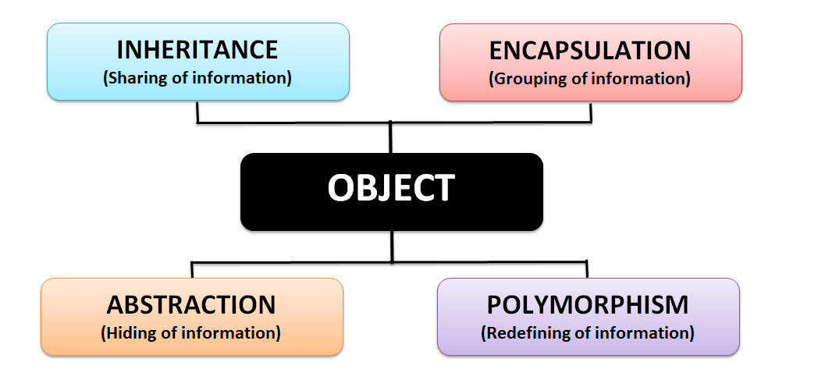
Pillars of OOPS

Slide 32
Encapsulation
Binding the data with the code that manipulates it.
It keeps the data and the code safe from external interference
Example :-
A power steering mechanism of a car. Power steering of a car is a complex system, which internally have lots of components tightly coupled together, they work synchronously to turn the car in the desired direction. It even controls the power delivered by the engine to the steering wheel. But to the external world there is only one interface is available and rest of the complexity is hidden. Moreover, the steering unit in itself is complete and independent. It does not affect the functioning of any other mechanism.

Slide 33
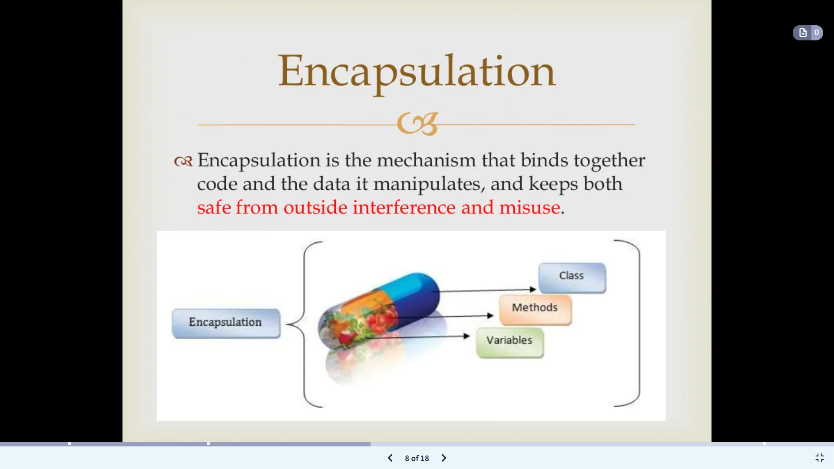
Encapsulation

Slide 34
Abstraction
Abstraction is a process of hiding the implementation details from the user, only the functionality will be provided to the user. In other words, the user will have the information on what the object does instead of how it does.
Example 1, when you login to your Amazon account online, you enter your user_id and password and press login, what happens when you press login, how the input data sent to amazon server, how it gets verified is all abstracted away from the you.
Example 2: A car in itself is a well-defined object, which is composed of several other smaller objects like a gearing system, steering mechanism, engine, which are again have their own subsystems. But for humans car is a one single object, which can be managed by the help of its subsystems, even if their inner details are unknown.

Slide 35
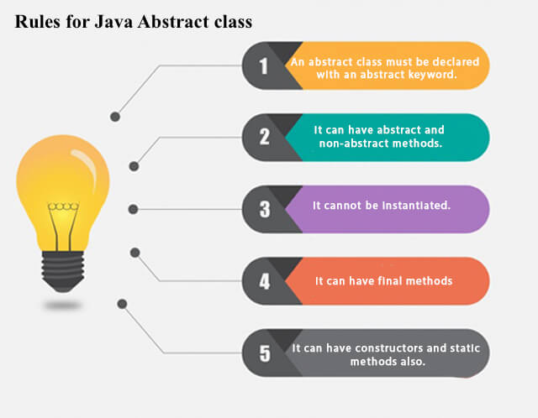
Abstraction

Slide 36
Abstraction
abstract class Bike{
abstract void run();
}
class Honda4 extends Bike{
void run(){System.out.println("running safely");}
public static void main(String args[]){
Bike obj = new Honda4();
obj.run();
}
}

Slide 37
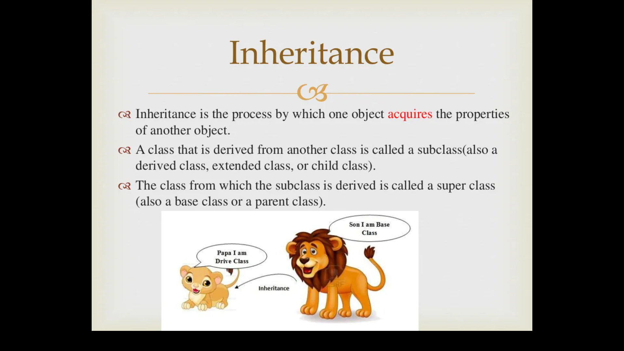
Inheritance
The mechanism of deriving a new class from an old one (existing class) such that the new class inherit all the members (variables and methods) of old class is called inheritance or derivation.
A class that is derived from another class is called a subclass (also a derived class, extended class or child class)
The class from which the subclass is derived is called a super class or base class or parent class

Slide 38
Inheritance
The old class is referred to as the Super class and the new one is called the Sub class.
Parent Class - Base Class or Super Class
Child Class - Derived Class or Sub Class
Father
Home
Money
Business
Parent Class
Child Class
Son
BMW
Job

Slide 39
Inheritance
For example:
Car is a four wheeler vehicle so assume that we have a class FourWheeler and a sub class of it named Car. Here Car acquires the properties of a class FourWheeler. Other classifications could be a jeep, van etc.
FourWheeler defines a class of vehicles that have four wheels, and specific range of engine power, load carrying capacity etc.
Car (termed as a sub-class) acquires these properties from FourWheeler, and has some specific properties, which are different from other classifications of FourWheeler, such as luxury, comfort, shape, size, usage etc.
A car can have further classification such as an open car, small car, big car etc, which will acquire the properties from both Four Wheeler and Car, but will still have some specific properties.

Slide 40
Advantage of Inheritance
Inheritance has a lot of benefits :
Extensibility
Reusability
Provide abstraction
Eliminates redundant code

Slide 41
Inheritance
class Employee{
float salary=40000;
}
class Programmer extends Employee{
int bonus=10000;
public static void main(String args[]){
Programmer p=new Programmer();
System.out.println("Programmer salary is:"+p.salary);
System.out.println("Bonus of Programmer is:"+p.bonus);
}
}

Slide 42
Polymorphism
Polymorphism is a word that came from two greek words, poly means many and morphos means forms.
If a variable, object or method perform different behavior according to situation, it is called polymorphism.
Example of a car
A car have a gear transmission system. It has four front gears and one backward gear. When the engine is accelerated then depending upon which gear is engaged different amount power and movement is delivered to the car. The action is same applying gear but based on the type of gear the action behaves differently or you can say that it shows many forms (polymorphism means many forms)

Slide 43
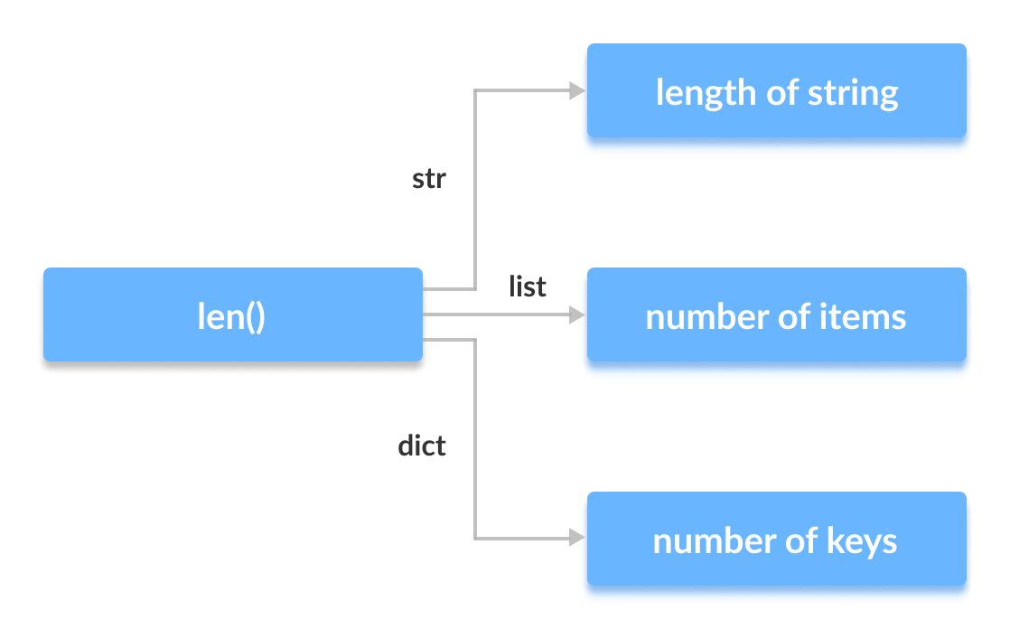
Polymorphism

Slide 44
Modeling Concepts
Object-oriented modeling and design is a way of thinking about problems using models organized around real world concepts.
The fundamental construct is the object, which combines both data structure and behavior.

Slide 45
Modeling Concepts
What is Modeling
Modeling consists of building an abstraction of reality.
Abstractions are simplifications because:
They ignore irrelevant details and
They only represent the relevant details.
What is relevant or irrelevant depends on the purpose of the model.

Slide 46
Modeling Concepts
What is a Model
A model is a simplification of reality.
A model may provide
blueprints of a system
Organization of the system
Dynamic of the system

Slide 47
Modeling Concepts
MODEL
A model is an abstraction, before building any system a prototype may be developed. The main purpose of model is for understanding of the system.
Designer build different kinds of models for various purposes before constructing things.
For example car , airplane, blueprints of machine parts, Plan for house construction etc., Models serve many purposes

Slide 48

Modeling Concepts

Slide 49

Modeling Concepts

Slide 50

Modeling Concepts

Slide 51
Modeling Concepts
Importance of Modeling
Models help us
to visualize a system as it is or as we want it to be.
to specify the structure or behavior of a system.
in providing a template that guides us in constructing a system.
in providing documenting the decisions we have made.

Slide 52
Modeling Concepts
Purpose of Modeling
Designers build many kinds of models for various purposes before constructing things.
Models serve several purposes –
Testing a physical entity before building (simulation)
Communication with customer
Visualization
Reduction of complexity
Better understanding of the problem

Slide 53
Modeling Concepts
Purpose of Modeling
Communication with customers
Architects and product designers build models to show their customers.
Mock ups are demonstration products that imitate some or all of the external behavior of a system.

Slide 54
Modeling Concepts
Purpose of Modeling
Visualization
Storyboards of movies, television shows and advertisements let writers see how their ideas flow. They can modify awkward transitions, and unnecessary segments before detailed writing begins.

Slide 55
Modeling Concepts
Purpose of Modeling
Reduction of complexity
The main reason for modeling is to deal with systems that are too complex to understand directly. Models reduce complexity by separating out a small number of important things to deal with at a time.

Slide 56
Modeling Concepts
UML
UML (Unified Modeling Language) is a general-purpose, graphical modeling language in the field of Software Engineering. UML is used to specify, visualize, construct, and document the artifacts (major elements) of the software system.
UML is composed of three main building blocks, i.e., things, relationships, and diagrams. Building blocks generate one complete UML model diagram by rotating around several different blocks. It plays an essential role in developing UML diagrams. The basic UML building blocks are enlisted below:
Things
Relationships
Diagrams

Slide 57
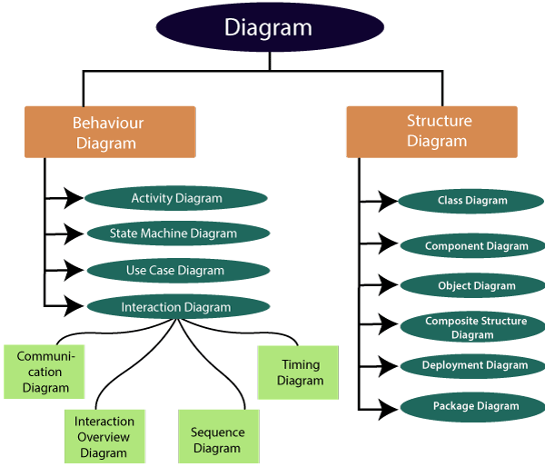
Modeling Concepts

Slide 58
Class Diagram
Class diagram is a static diagram. It represents the static view of an application.
Class diagram is not only used for visualizing, describing, and documenting different aspects of a system but also for constructing executable code of the software application.
It is the only diagram that is widely used for construction, and it can be mapped with object-oriented languages.
Following are the purpose of class diagrams given below:
It analyses and designs a static view of an application.
It describes the major responsibilities of a system.
It is a base for component and deployment diagrams.
It incorporates forward and reverse engineering.

Slide 59
Class Diagram
A class is a description of a set of objects that share the same attributes, operations, relationships, and semantics.
Graphically, a class is rendered as a rectangle, usually including its name, attributes, and operations in separate, designated compartments.
ClassName
attributes
operations

Slide 60
Class Diagram
ClassName
attributes
operations
The name of the class is the only required tag in the graphical representation of a class. It always appears in the top-most compartment.

Slide 61
Class Diagram
Person
name : String address : Address birthdate : Date ssn : Id
An attribute is a named property of a
class that describes the object being modeled.
In the class diagram, attributes appear in the second compartment just below the name-compartment.

Slide 62
Class Diagram
Person
name : String address : Address birthdate : Date ssn : Id
eat sleep work play
Operations describe the class behavior and appear in the third compartment.

Slide 63
An example of Class
Class Diagram
Account_Name
Custom_Name Balance
+AddFunds( ) +WithDraw( ) +Transfer( )
Name
Attributes
Operations

Slide 64
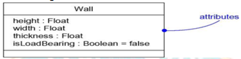
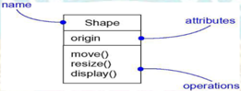
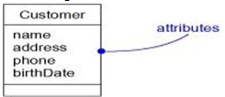
Class Diagram
Attributes
An attribute is a named property of a class that describes a range of values that instances of the property may hold.
A class may have any number of attributes or no attributes at all.
An attribute represents some property of the thing you are modeling that is shared by all objects of that class.

Slide 65
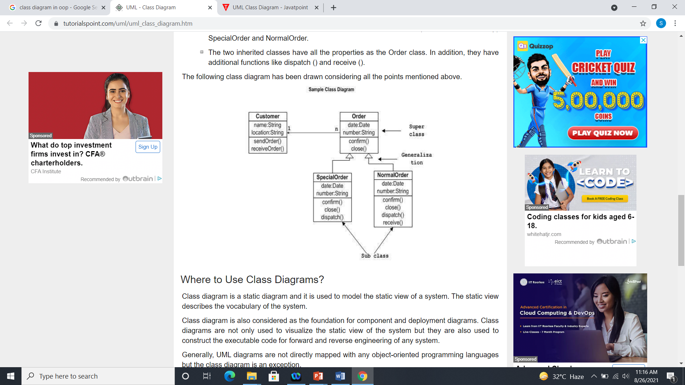
Class Diagram
The following diagram is an example of an Order System of an application. It describes a particular aspect of the entire application.

Slide 66
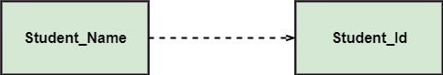
Class Diagram
Relationships
In UML, relationships are of three types:
Dependency:
A dependency is a semantic relationship between two or more classes where a change in one class cause changes in another class. It forms a weaker relationship. In the following example, Student_Name is dependent on the Student_Id.

Slide 67
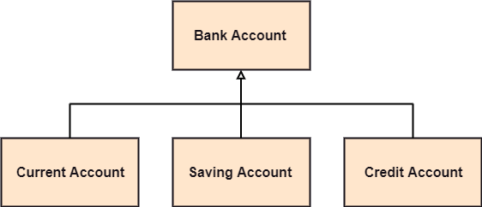
Class Diagram
Generalization:
A generalization is a relationship between a parent class (superclass) and a child class (subclass). In this, the child class is inherited from the parent class.
For example, The Current Account, Saving Account, and Credit Account are the generalized form of Bank Account.

Slide 68
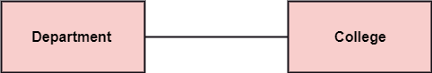
Class Diagram
Association:
It describes a static or physical connection between two or more objects. It depicts how many objects are there in the relationship.
For example, a department is associated with the college.

Slide 69
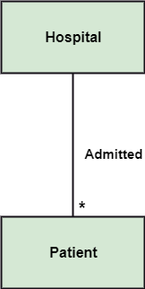
Class Diagram
Multiplicity:
It defines a specific range of allowable instances of attributes. In case if a range is not specified, one is considered as a default multiplicity.
For example, multiple patients are admitted to one hospital.

Slide 70
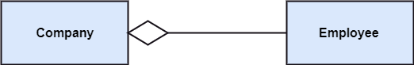
Class Diagram
Aggregation:
An aggregation is a subset of association, which represents has a relationship. It is more specific then association. It defines a part-whole or part-of relationship. In this kind of relationship, the child class can exist independently of its parent class.
The company encompasses a number of employees, and even if one employee resigns, the company still exists.

Slide 71
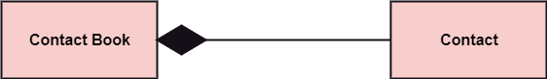
Class Diagram
Composition:
The composition is a subset of aggregation. It portrays the dependency between the parent and its child, which means if one part is deleted, then the other part also gets discarded. It represents a whole-part relationship.
A contact book consists of multiple contacts, and if you delete the contact book, all the contacts will be lost.

Slide 72
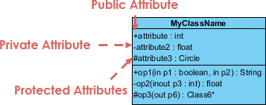
Class Diagram
Class Visibility
The +, - and # symbols before an attribute and operation name in a class denote the visibility of the attribute and operation.
+ denotes public attributes or operations
- denotes private attributes or operations
# denotes protected attributes or operations

Slide 73
Class Diagram
How to draw a Class Diagram?
The class diagram is used most widely to construct software applications. It not only represents a static view of the system but also all the major aspects of an application. A collection of class diagrams as a whole represents a system.
Some key points that are needed to keep in mind while drawing a class diagram are given below:
To describe a complete aspect of the system, it is suggested to give a meaningful name to the class diagram.
The objects and their relationships should be acknowledged in advance.
The attributes and methods (responsibilities) of each class must be known.
A minimum number of desired properties should be specified as more number of the unwanted property will lead to a complex diagram.
Notes can be used as and when required by the developer to describe the aspects of a diagram.
The diagrams should be redrawn and reworked as many times to make it correct before producing its final version.

Slide 74
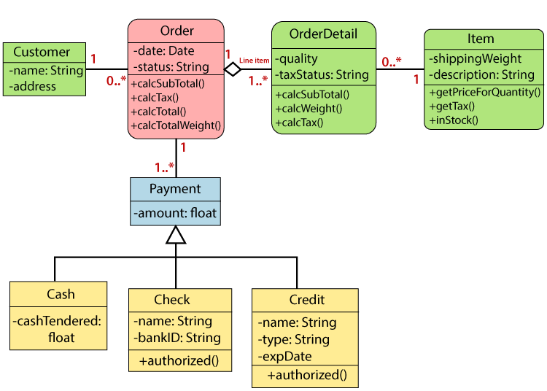
Class Diagram(Class Diagram Example)

Slide 75
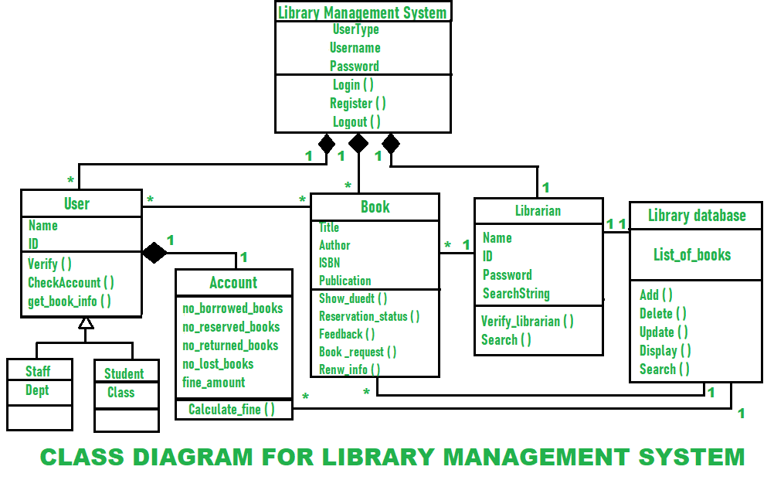
Class Diagram(Class Diagram Example)

Slide 76
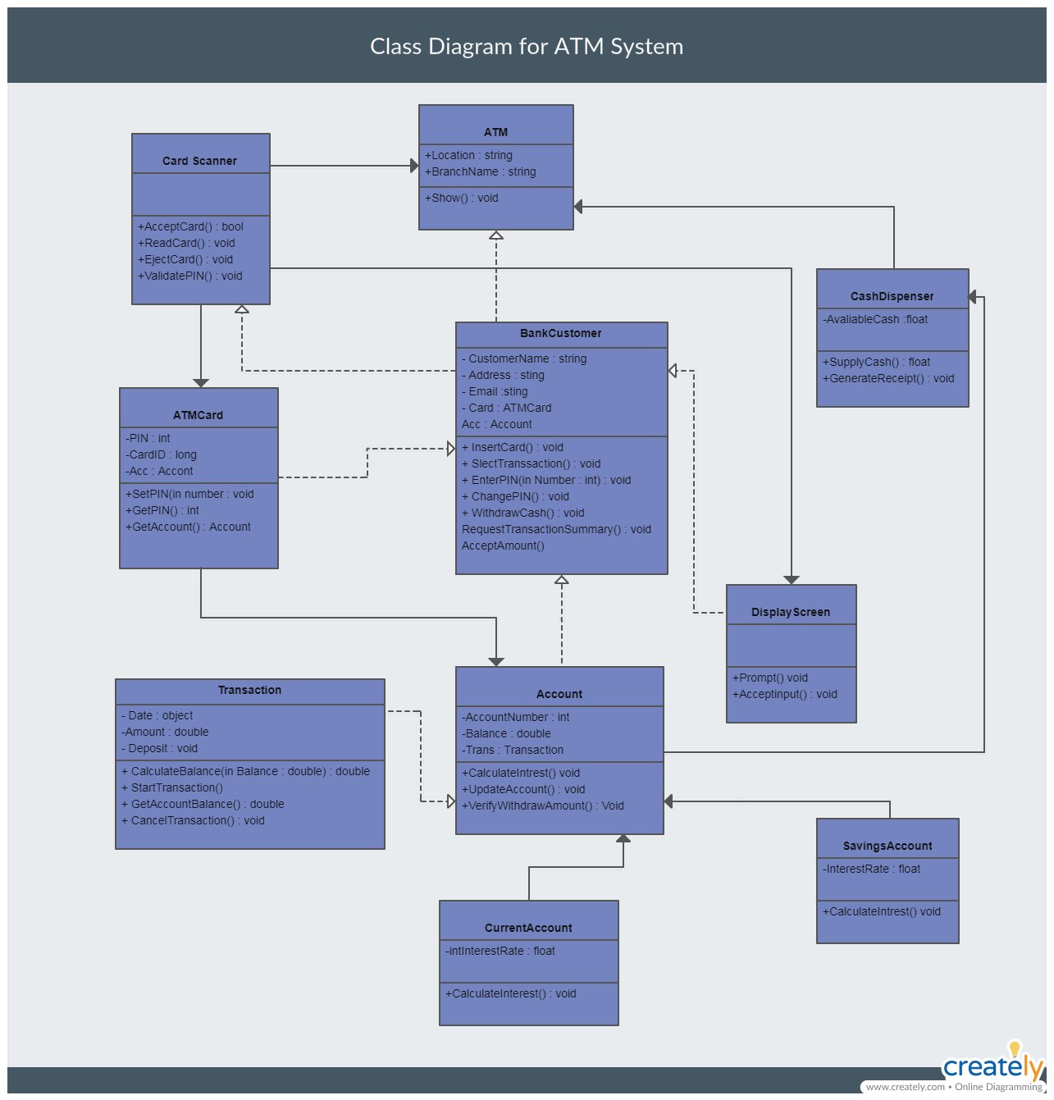
Class Diagram(Class Diagram Example)

Slide 77
Class Diagram
The following points should be remembered while drawing a class diagram −
The name of the class diagram should be meaningful to describe the aspect of the system.
Each element and their relationships should be identified in advance.
Responsibility (attributes and methods) of each class should be clearly identified
For each class, minimum number of properties should be specified, as unnecessary properties will make the diagram complicated.
Use notes whenever required to describe some aspect of the diagram. At the end of the drawing it should be understandable to the developer/coder.
Finally, before making the final version, the diagram should be drawn on plain paper and reworked as many times as possible to make it correct.

Slide 78
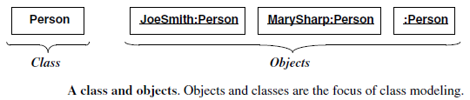
Object Diagram
Object
An object is a concept, abstraction, or thing with identity that has meaning for an application.
Objects often appear as proper nouns or specific references in problem descriptions and discussions with users.
Some objects have real-world entity like table, tree

Slide 79
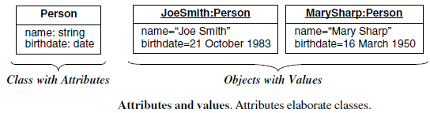
Object Diagram
Attribute and Value of an object
Each attribute is associated a specific value.

Slide 80
Object Diagram
Object diagrams are derived from class diagrams so object diagrams are dependent upon class diagrams.
Object diagrams also represent the static view of a system but this static view is a snapshot of the system at a particular moment.
The purpose of the object diagram can be summarized as
Forward and reverse engineering.
Object relationships of a system
Static view of an interaction.
Understand object behavior and their relationship from practical perspective

Slide 81
Object Diagram
The following things should be remembered and understood clearly −
Object diagrams consist of objects.
The link in object diagram is used to connect objects.
Objects and links are the two elements used to construct an object diagram.
The object diagram should have a meaningful name to indicate its purpose.
The most important elements are to be identified.
The association among objects should be clarified.
Values of different elements need to be captured to include in the object diagram.
Add proper notes at points where more clarity is required.

Slide 82
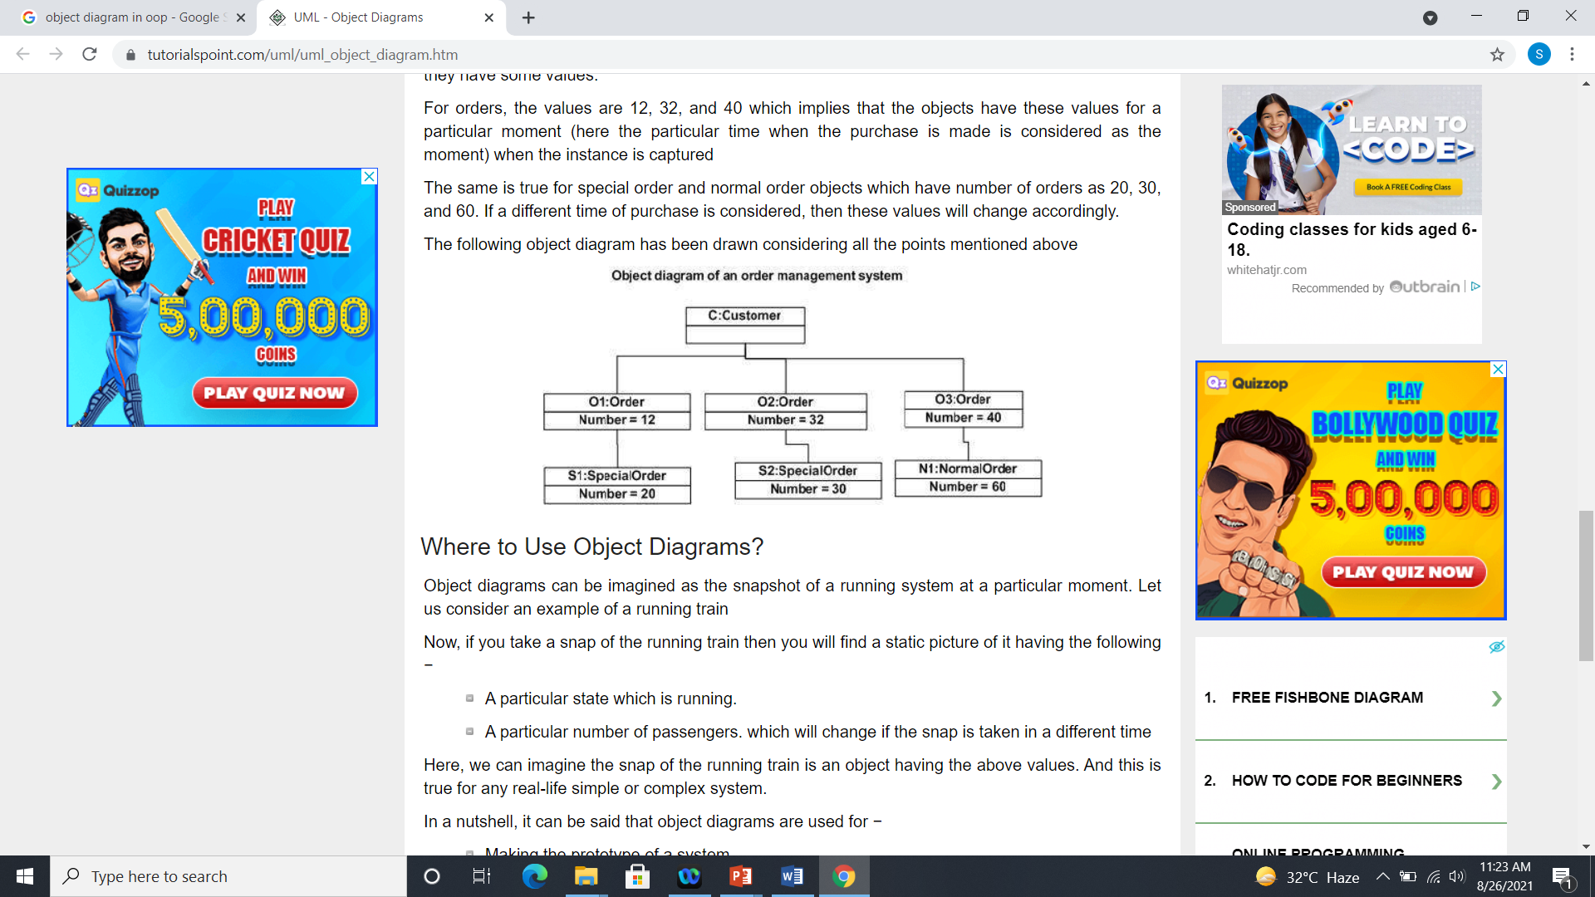
Object Diagram
The following diagram is an example of an object diagram. It represents the Order management system

Slide 83
Object Diagram
Serial No. | Class Diagram | Object Diagram
1. | It depicts the static view of a system. | It portrays the real-time behavior of a system.
2. | Dynamic changes are not included in the class diagram. | Dynamic changes are captured in the object diagram.
3. | The data values and attributes of an instance are not involved here. | It incorporates data values and attributes of an entity.
4. | The object behavior is manipulated in the class diagram. | Objects are the instances of a class.

Slide 84
Control statements
Java compiler executes the code from top to bottom.
The statements in the code are executed according to the order in which they appear. However, java provides statements that can be used to control the flow of Java code. Such statements are called control flow statements.
Java provides three types of control flow statements:
Decision Making statements
Loop statements
Jump statements

Slide 85
Decision Making statements
Decision-making statements decide which statement to execute and when.
Decision-making statements evaluate the Boolean expression and control the program flow depending upon the result of the condition provided.

Slide 86
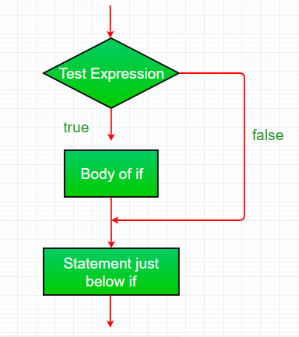
Decision Making statements
1.If Statement:
In Java, the "if" statement is used to evaluate a condition. The control of the program is diverted depending upon the specific condition.

Slide 87
Decision Making statements
1.If Statement:
In Java, the "if" statement is used to evaluate a condition. The control of the program is diverted depending upon the specific condition.
//Java Program to demonstate the use of if statement.
public class IfExample {
public static void main(String[] args) {
//defining an 'age' variable
int age=20;
//checking the age
if(age>18){
System.out.print("Age is greater than 18");
}
}
}

Slide 88
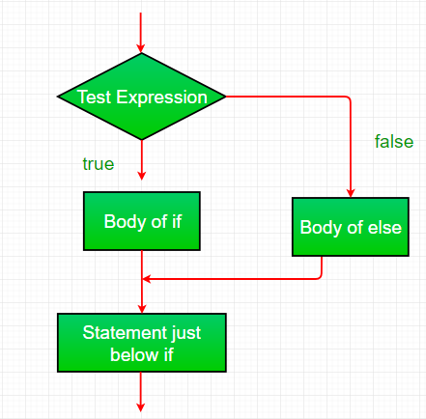
Decision Making statements
If-else:
We can use the else statement with if statement to execute a block of code when the condition is false.

Slide 89
Decision Making statements
If-else:
We can use the else statement with if statement to execute a block of code when the condition is false.
public class IfElseExample {
public static void main(String[] args) {
//defining a variable
int number=13;
//Check if the number is divisible by 2 or not
if(number%2==0){
System.out.println("even number");
}else{
System.out.println("odd number");
}
}
}

Slide 90
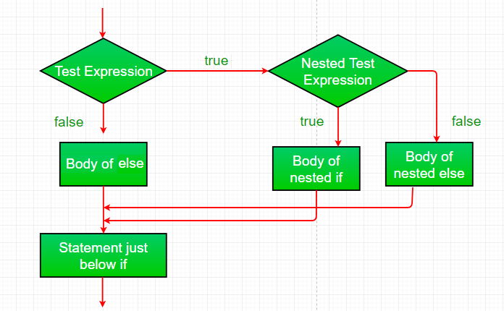
Decision Making statements
Nested-if:
A nested if is an if statement that is the target of another if or else. Nested if statements means an if statement inside an if statement.

Slide 91
Decision Making statements
//Java Program to demonstrate the use of Nested If Statement.
public class JavaNestedIfExample {
public static void main(String[] args) {
//Creating two variables for age and weight
int age=20;
int weight=80;
//applying condition on age and weight
if(age>=18){
if(weight>50){
System.out.println("You are eligible to donate blood");
}
}
}}

Slide 92
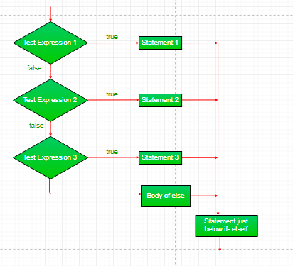
Decision Making statements
if-else-if-ladder:
if statements are executed from the top down.
As soon as one of the conditions controlling the if is true, the statement associated with that if is executed, and the rest of the ladder is bypassed.

Slide 93
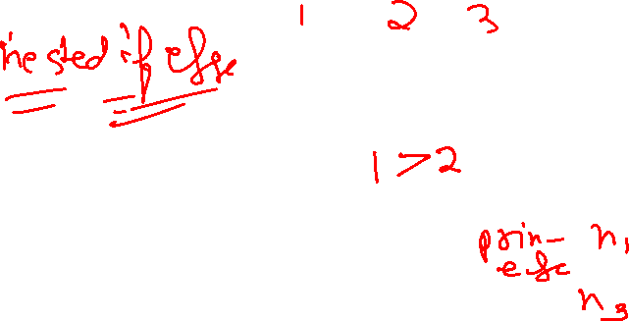
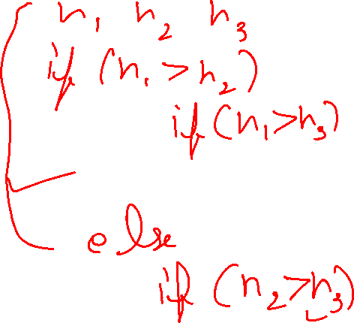
Decision Making statements
public class PositiveNegativeExample {
public static void main(String[] args) {
int number=-13;
if(number>0){
System.out.println("POSITIVE");
}else if(number<0){
System.out.println("NEGATIVE");
}else{
System.out.println("ZERO");
}
}
}

Slide 94
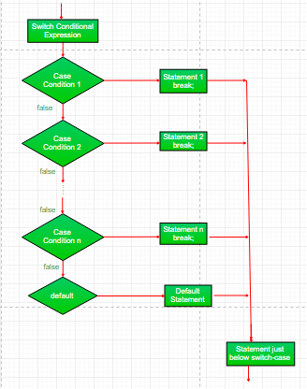
Decision Making statements
switch statement
The switch statement is a multiway branch statement. It provides an easy way to dispatch execution to different parts of code based on the value of the expression. Syntax:

Slide 95
Decision Making statements
public class SwitchExample {
public static void main(String[] args) {
//Declaring a variable for switch expression
int number=20;
//Switch expression
switch(number){
//Case statements
case 10: System.out.println("10");
break;
case 20: System.out.println("20");
break;
case 30: System.out.println("30");
break;
//Default case statement
default:System.out.println("Not in 10, 20 or 30");
}
}
}

Slide 96
Decision Making statements
Example:
Finding Month
2. Program to check Vowel or Consonant:

Slide 97
Decision Making statements
Java Switch Statement is fall-through
The Java switch statement is fall-through. It means it executes all statements after the first match if a break statement is not present.
Java Switch Statement with String
Java allows us to use strings in switch expression since Java SE 7. The case statement should be string literal.
Java Nested Switch Statement
We can use switch statement inside other switch statement in Java. It is known as nested switch statement.
Java Enum in Switch Statement
Java allows us to use enum in switch statement. Java enum is a class that represent the group of constants. (immutable such as final variables). We use the keyword enum and put the constants in curly braces separated by comma

Slide 98
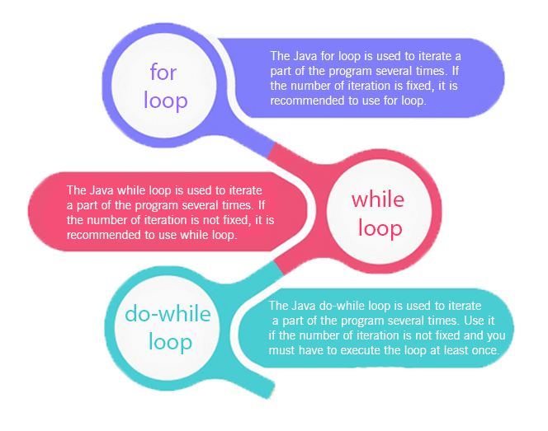
Looping
Loops in Java
The Java for loop is used to iterate a part of the program several times. If the number of iteration is fixed, it is recommended to use for loop.

Slide 99
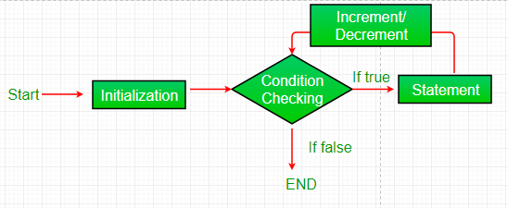
Looping
for loop:
for loop provides a concise way of writing the loop structure.
Unlike a while loop, a for statement consumes the initialization, condition and increment/decrement in one line thereby providing a shorter, easy to debug structure of looping.

Slide 100
Looping
Initialization condition: Here, we initialize the variable in use. It marks the start of a for loop. An already declared variable can be used or a variable can be declared, local to loop only.
Testing Condition: It is used for testing the exit condition for a loop. It must return a boolean value. It is also an Entry Control Loop as the condition is checked prior to the execution of the loop statements.
Statement execution: Once the condition is evaluated to true, the statements in the loop body are executed.
Increment/ Decrement: It is used for updating the variable for next iteration.
Loop termination:When the condition becomes false, the loop terminates marking the end of its life cycle.

Slide 101
Looping
//Java Program to demonstrate the example of for loop
//which prints table of 1
public class ForExample {
public static void main(String[] args) {
//Code of Java for loop
for(int i=1;i<=10;i++){
System.out.println(i);
}
}
}

Slide 102
Looping
Java Nested for Loop
If we have a for loop inside the another loop, it is known as nested for loop. The inner loop executes completely whenever outer loop executes.
public class NestedForExample {
public static void main(String[] args) {
//loop of i
for(int i=1;i<=3;i++){
//loop of j
for(int j=1;j<=3;j++){
System.out.println(i+" "+j);
}//end of i
}//end of j
}
}

Slide 103
Looping
Java for-each Loop
The for-each loop is used to traverse array or collection in Java. It is easier to use than simple for loop because we don't need to increment value and use subscript notation.
It works on the basis of elements and not the index. It returns element one by one in the defined variable.
Syntax:
for(data_type variable : array_name){
//code to be executed
}
public class ForEachExample {
public static void main(String[] args) {
//Declaring an array
int arr[]={12,23,44,56,78};
//Printing array using for-each loop
for(int i:arr){
System.out.println(i);
}
}
}

Slide 104
Looping
Java Labeled For Loop
We can have a name of each Java for loop. To do so, we use label before the for loop. It is useful while using the nested for loop as we can break/continue specific for loop.
Syntax:
labelname:
for(initialization; condition; increment/decrement){
}

Slide 105
Looping
public class LabeledForExample {
public static void main(String[] args) {
//Using Label for outer and for loop
aa:
for(int i=1;i<=3;i++){
bb:
for(int j=1;j<=3;j++){
if(i==2&&j==2){
break aa;
}
System.out.println(i+" "+j);
}
}
}
}

Slide 106
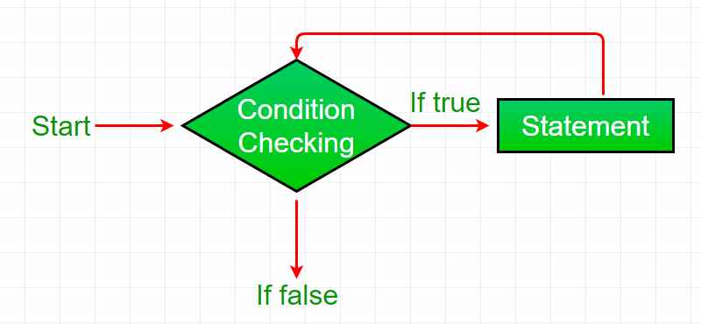
Looping
While loop:
A while loop is a control flow statement that allows code to be executed repeatedly based on a given Boolean condition. The while loop can be thought of as a repeating if statement.
While loop starts with the checking of condition. If it evaluated to true, then the loop body statements are executed otherwise first statement following the loop is executed. For this reason it is also called Entry control loop

Slide 107



















Looping
public class WhileExample {
public static void main(String[] args) {
int i=1;
while(i<=10){
System.out.println(i);
i++;
}
}
}

Slide 108
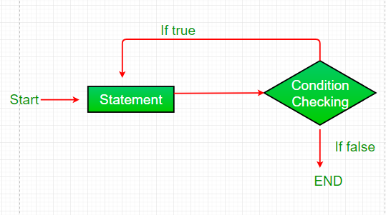
Looping
Do-while:
do while loop is similar to while loop with only difference that it checks for condition after executing the statements, and therefore is an example of Exit Control Loop.
do while loop starts with the execution of the statement(s). There is no checking of any condition for the first time.

Slide 109
Looping
public class DoWhileExample {
public static void main(String[] args) {
int i=1;
do{
System.out.println(i);
i++;
}while(i<=10);
}
}

Slide 110
Looping
Comparison | for loop | while loop | do-while loop
Introduction | The Java for loop is a control flow statement that iterates a part of the programs multiple times. | The Java while loop is a control flow statement that executes a part of the programs repeatedly on the basis of given boolean condition. | The Java do while loop is a control flow statement that executes a part of the programs at least once and the further execution depends upon the given boolean condition.
When to use | If the number of iteration is fixed, it is recommended to use for loop. | If the number of iteration is not fixed, it is recommended to use while loop. | If the number of iteration is not fixed and you must have to execute the loop at least once, it is recommended to use the do-while loop.
Syntax | for(init;condition;incr/decr){ // code to be executed } | while(condition){ //code to be executed } | do{ //code to be executed }while(condition);
Example | //for loop for(int i=1;i<=10;i++){ System.out.println(i); } | //while loop int i=1; while(i<=10){ System.out.println(i); i++; } | //do-while loop int i=1; do{ System.out.println(i); i++; }while(i<=10);
Syntax for infinitive loop | for(;;){ //code to be executed } | while(true){ //code to be executed } | do{ //code to be executed }while(true);

Slide 111
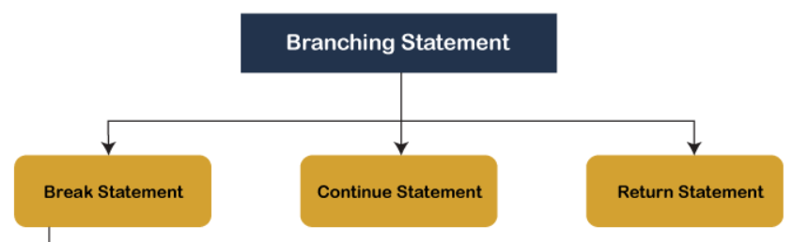
Branching statements
Branching statements are the statements used to jump the flow of execution from one part of a program to another.
The branching statements are mostly used inside the control statements.

Slide 112
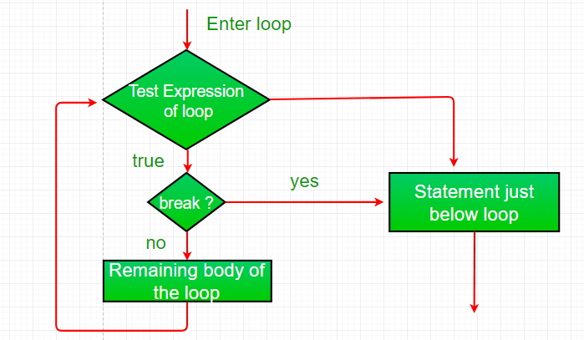
Branching statements
The break Statement
Using break, we can force immediate termination of a loop, bypassing the conditional expression and any remaining code in the body of the loop.

Slide 113
Branching statements
Java Break Statement
When a break statement is encountered inside a loop, the loop is immediately terminated and the program control resumes at the next statement following the loop.
The Java break statement is used to break loop or switch statement. It breaks the current flow of the program at specified condition. In case of inner loop, it breaks only inner loop.
We can use Java break statement in all types of loops such as for loop, while loop and do-while loop.
Syntax:
jump-statement;
break;

Slide 114
Branching statements
//Java Program to demonstrate the use of break statement
//inside the for loop.
public class BreakExample {
public static void main(String[] args) {
//using for loop
for(int i=1;i<=10;i++){
if(i==5){
//breaking the loop
break;
}
System.out.println(i);
}
}
}

Slide 115
Branching statements
Java Break Statement with Labeled For Loop
We can use break statement with a label. The feature is introduced since JDK 1.5. So, we can break any loop in Java now whether it is outer or inner loop.
public class BreakExample3 {
public static void main(String[] args) {
aa:
for(int i=1;i<=3;i++){
bb:
for(int j=1;j<=3;j++){
if(i==2&&j==2){
break aa;
}
System.out.println(i+" "+j);
}
}
} }

Slide 116
Branching statements
Java Break Statement in while loop
public class BreakWhileExample {
public static void main(String[] args) {
//while loop
int i=1;
while(i<=10){
if(i==5){
//using break statement
i++;
break;//it will break the loop
}
System.out.println(i);
i++;
}
}
}

Slide 117
Branching statements
Java Break Statement in do-while loop
public class BreakDoWhileExample {
public static void main(String[] args) {
int i=1;
do{
if(i==5){
//using break statement
i++;
break;//it will break the loop
}
System.out.println(i);
i++;
}while(i<=10);
}
}

Slide 118
Branching statements
Java Break Statement with Switch
To understand the example of break with switch statement, please visit Switch slide.
switch(expression){
case value1:
//code to be executed;
break; //optional
case value2:
//code to be executed;
break; //optional
......
default:
code to be executed if all cases are not matched;
}

Slide 119
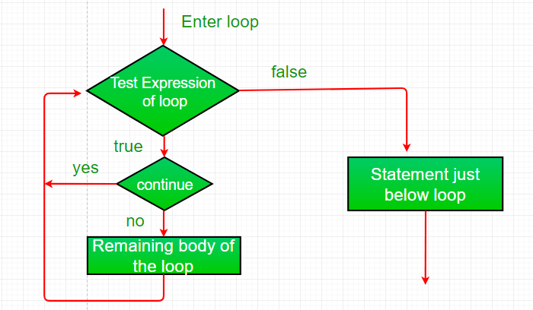
Branching statements
Continue:
Sometimes it is useful to force an early iteration of a loop. That is, you might want to continue running the loop but stop processing the remainder of the code in its body for this particular iteration.

Slide 120
Branching statements
Java Continue Statement
The continue statement is used in loop control structure when you need to jump to the next iteration of the loop immediately. It can be used with for loop or while loop.
The Java continue statement is used to continue the loop. It continues the current flow of the program and skips the remaining code at the specified condition. In case of an inner loop, it continues the inner loop only.
We can use Java continue statement in all types of loops such as for loop, while loop and do-while loop.
Syntax:
jump-statement;
continue;

Slide 121
Branching statements
//Java Program to demonstrate the use of continue statement
//inside the for loop.
public class ContinueExample {
public static void main(String[] args) {
//for loop
for(int i=1;i<=10;i++){
if(i==5){
//using continue statement
continue;//it will skip the rest statement
}
System.out.println(i);
}
}
}

Slide 122
Branching statements
Java Continue Statement with Inner Loop
It continues inner loop only if you use the continue statement inside the inner loop.
public class ContinueExample2 {
public static void main(String[] args) {
//outer loop
for(int i=1;i<=3;i++){
//inner loop
for(int j=1;j<=3;j++){
if(i==2&&j==2){
continue;
}
System.out.println(i+" "+j);
}
}
}
}

Slide 123
Branching statements
Java Continue Statement with Labelled For Loop
We can use continue statement with a label. This feature is introduced since JDK 1.5. So, we can continue any loop in Java now whether it is outer loop or inner.
public class ContinueExample3 {
public static void main(String[] args) {
aa:
for(int i=1;i<=3;i++){
bb:
for(int j=1;j<=3;j++){
if(i==2&&j==2){
continue aa;
}
System.out.println(i+" "+j);
}
}
}
}

Slide 124
Branching statements
Java Continue Statement in while loop
public class ContinueWhileExample {
public static void main(String[] args) {
int i=1;
while(i<=10){
if(i==5){
i++;
continue;//it will skip the rest statement
}
System.out.println(i);
i++;
}
}
}

Slide 125
Branching statements
Java Continue Statement in do-while Loop
public class ContinueDoWhileExample {
public static void main(String[] args) {
//declaring variable
int i=1;
do{
if(i==5){
i++;
continue;//it will skip the rest statement
}
System.out.println(i);
i++;
}while(i<=10);
}
}

Slide 126
Branching statements
Java Continue Statement in do-while Loop
public class ContinueDoWhileExample {
public static void main(String[] args) {
//declaring variable
int i=1;
do{
if(i==5){
i++;
continue;//it will skip the rest statement
}
System.out.println(i);
i++;
}while(i<=10);
}
}

Slide 127
Branching statements
BASIS FOR COMPARISON | BREAK | CONTINUE
Task | It terminates the execution of remaining iteration of the loop. | It terminates only the current iteration of the loop.
Control after break/continue | 'break' resumes the control of the program to the end of loop enclosing that 'break'. | 'continue' resumes the control of the program to the next iteration of that loop enclosing 'continue'.
Causes | It causes early termination of loop. | It causes early execution of the next iteration.
Continuation | 'break' stops the continuation of loop. | 'continue' do not stops the continuation of loop, it only stops the current iteration.
Other uses | 'break' can be used with 'switch', 'label'. | 'continue' can not be executed with 'switch' and 'labels'.

Slide 128
Branching statements
Return:
The return statement is used to explicitly return from a method. That is, it causes a program control to transfer back to the caller of the method.

Slide 129
Argument Passing Mechanism
Arguments in Java are always passed-by-value.
During method invocation, a copy of each argument, whether its a value or reference, is created in stack memory which is then passed to the method.
When we pass an object, the reference in stack memory is copied and the new reference is passed to the method.

Slide 130
Command Line Argument
Command line argument is a parameter supplied to the program when it is invoked.
Command line argument is an important concept in programming.
It is mostly used when you need to control your program from outside.
Command line arguments are passed to the main() method.

Slide 131
Command Line Argument
To pass command line arguments, we typically define main() with two arguments : first argument is the number of command line arguments and second is list of command-line arguments.
int main(int argc, char *argv[]) { /* ... */ }
argc (ARGument Count) is int and stores number of command-line arguments passed by the user including the name of the program. So if we pass a value to a program, value of argc would be 2 (one for argument and one for program name).The value of argc should be non negative.
argv(ARGument Vector) is array of character pointers listing all the arguments.
If argc is greater than zero,the array elements from argv[0] to argv[argc-1] will contain pointers to strings.

Slide 132
Command Line Argument
class CommandLineExample{
public static void main(String args[]){
System.out.println("Your first argument is: "+args[0]);
}
}

Slide 133
Daily Quiz
Explain the concept of Polymorphism.
Class Diagram is a________ diagram Static
Decision-making statements evaluate the _________ expression Boolean
Using ________, we can force immediate termination of a loop break
The ________ statement is used to explicitly return from a method return
Can we hide data in OOPS? If yes, elaborate. [CO1]

Slide 134
MCQ
4. Which of the following is used with the switch statement? a) Continue b) Exit c) break d) do
Ans C
2. Which of the following is not a valid flow control statement? a) exit() b) break c) continue d) return
Ans A
3. Can command line arguments be converted into int automatically if required? a) Yes b) No
Ans B
Which of the following is not an OOP concept?
Encapsulation
Polymorphism
Exception
Abstraction
Ans C
2. A single program of OOPS contains _______ classes?
Only 1
Only 999
Only 100
Any number
Ans D
3. The while loop repeats a set of code while the condition is not met? a)True b) False
Ans B

Slide 135
Glossary Questions
1. Attempt all the parts. Pick the correct option from glossary. [CO1]
i) Abstraction ii) Encapsulation iii) Inheritance iv) Polymorphism
a) _________ means one entity have different behaviours in different situations.
b) _________ is used to bind the code and data.
c) _________ is used to hide the necessary details from outside world.
d) _________ is used to acquire properties of one class into other.
2. Attempt all the parts. Pick the correct option from glossary. [CO1] i) Super class ii) Sub class iii) Reusability iv) Redundant code a) Inheritance can eliminate _________. b) A parent class is also known as _________ . c) Using an existing code is known as ________. d) A child class is also known as _________ .

Slide 136
Recap of Unit
The main aim of OOP is to bind together the data and the functions that operate on them so that no other part of the code can access this data except that function.
Object-oriented modeling and design is a way of thinking about problems using models organized around real world concepts.
Decision-making statements evaluate the Boolean expression and control the program flow depending upon the result of the condition provided.

